Slide 1

Multilayer films

Slide 2
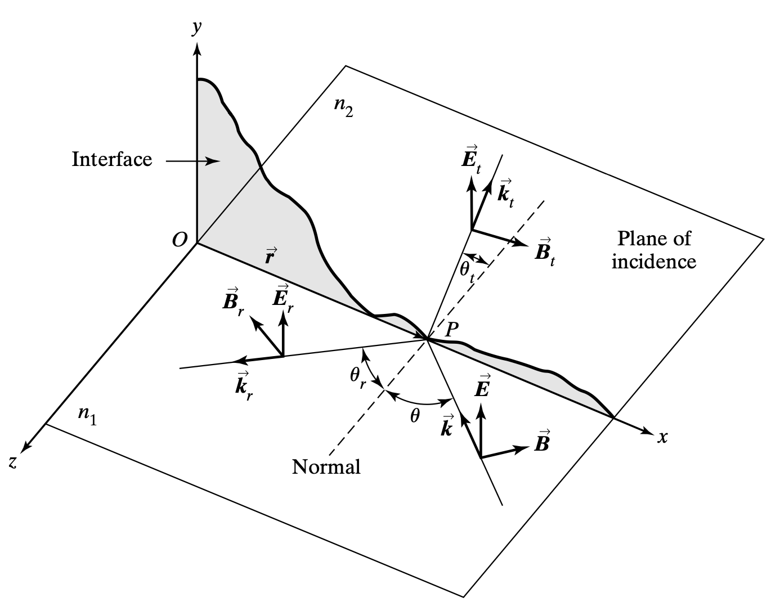
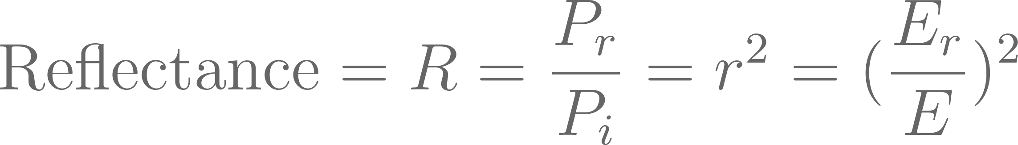
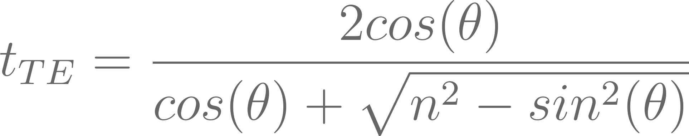
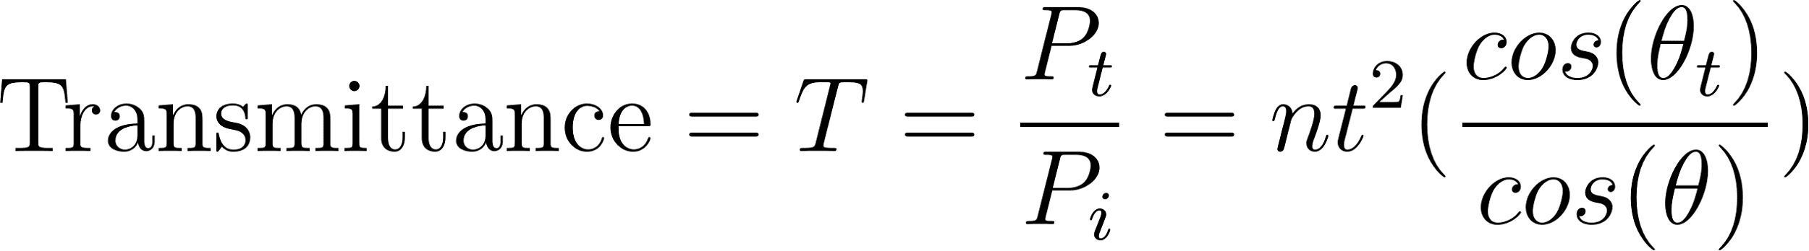
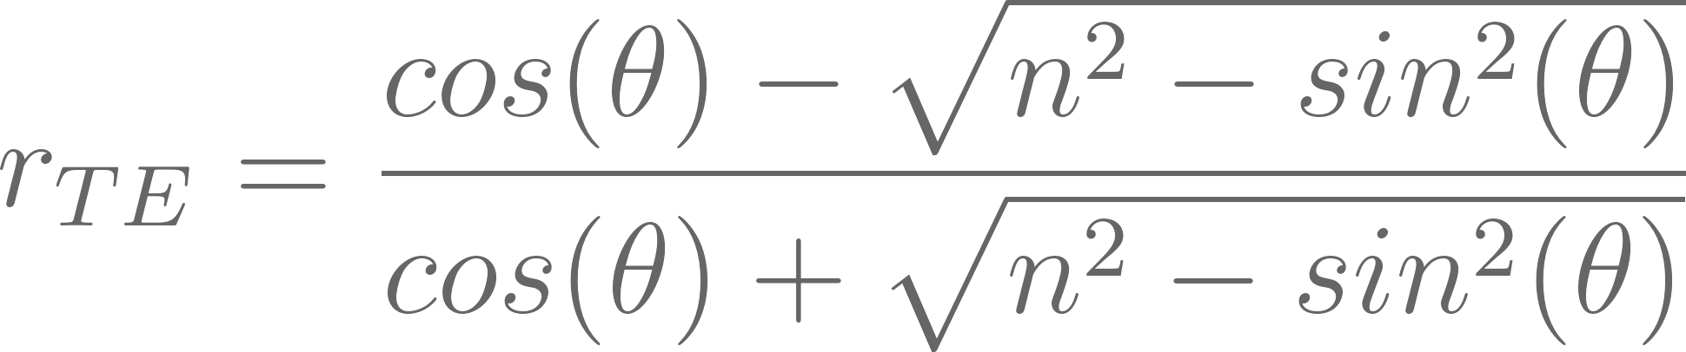
Recap
Question: In a basic linearly polarized electromagnetic wave model, can we derive equations to quantify the reflection and transmission of the incident wave in terms of irradiance?
Answer: The Fresnel Equations.

Slide 3
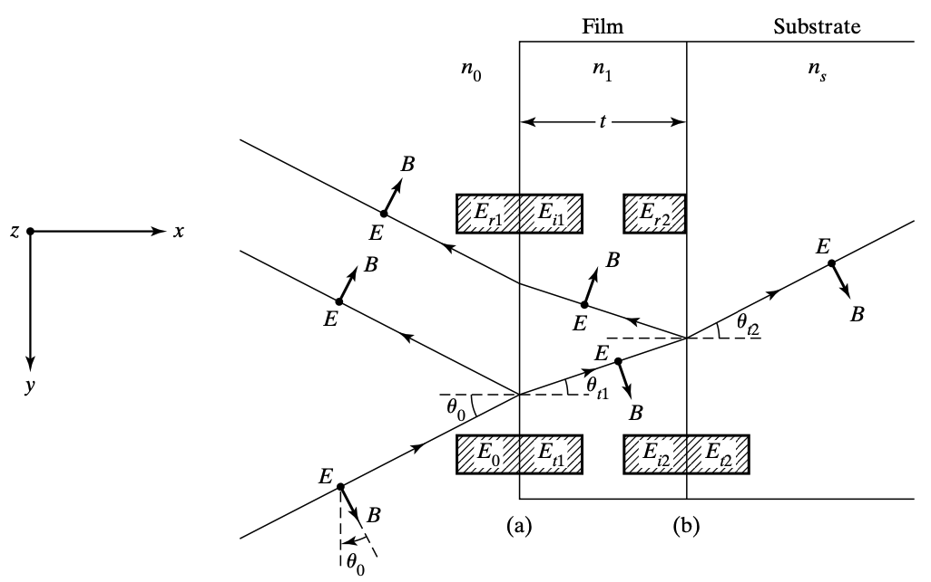
The Transfer Matrix – Set-Up.
Assumptions:
- The material is homogeneous and isotropic.
- The thickness of the film is of the order of wavelength of light.
Notes:
The beam undergoes external reflection at the interface (a) and internal reflection at the interface (b).
Er1 represents the sum of all the multiply reflected beams at the interface (a) in the process of emerging from the film.
Ei2 represents the sum of all the multiple beams incident at the interface (b) and directed toward the substrate.
-----------
In the context of materials or media:
- **Homogeneous:** The material is uniform, meaning its properties are identical at every point in space. There are no variations or irregularities.
- **Isotropic:** The material has the same properties in all directions. The physical characteristics (such as optical, thermal, or mechanical properties) do not depend on the orientation of the material.

Slide 4
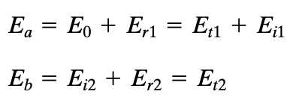
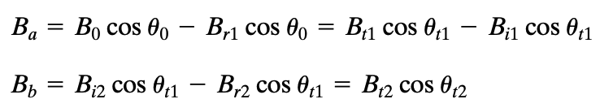
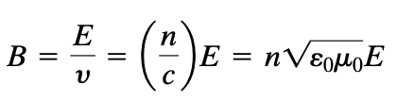
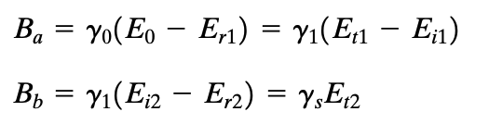
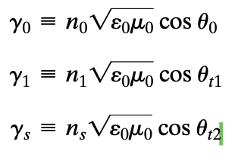
Transfer Matrix – Boundary Conditions.
The boundary conditions for the electric and magnetic fields of the incident plane waves on both interfaces are derived from Maxwell's equations, ensuring equal magnitudes on either side.
With the help of:

Slide 5

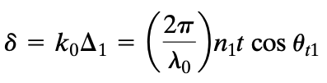


Transfer Matrix – Boundary Conditions.
The optical path length associated with 2 traversals of the thin film is
E_i2 differs from E_t1 only because of a phase difference that develops due to ONE traversal of the film

Slide 6
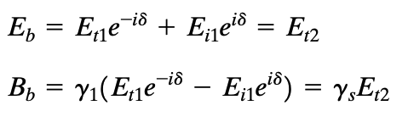
Transfer Matrix – Boundary Conditions.
Using what we have, we can replace E_i2 and E_r2 in the boundary condition equations.

Slide 7
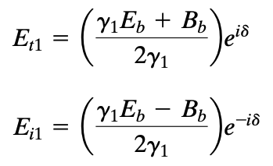
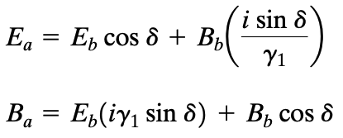
Transfer Matrix – Boundary Conditions.
PAUSE: Our objective is to establish a method for determining the electric and magnetic field components at one interface based on the components from the preceding interface using a matrix.
We can solve for E_t1 and E_i1
Related the fields at one boundary with those at the other.

Slide 8
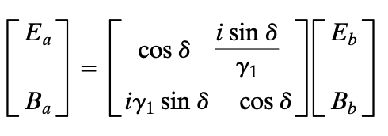
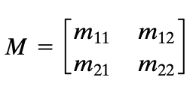
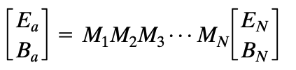
THE TRANSFER MATRIX!!!
If boundary (b) is the interface of another film layer, rather than the substrate, we can still use the transfer matrix. Now fields at b will be related to the fields at c at the back boundary of the second film layer by a second transfer matrix.

Slide 9
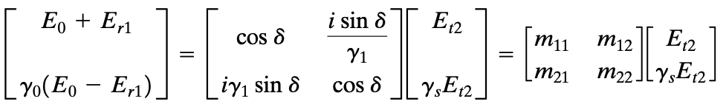
Transfer Matrix and Reflection
Back to the terms we neglected.

Slide 10
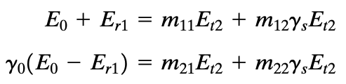

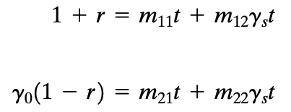
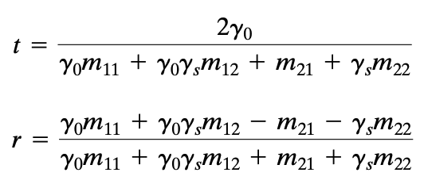
Transfer Matrix and Reflection
Recall:

Slide 11




Reflection at Normal Incidence
The beam remains normal at all interfaces so that all angles of incidence, reflection, and refraction are ZERO!

Slide 12
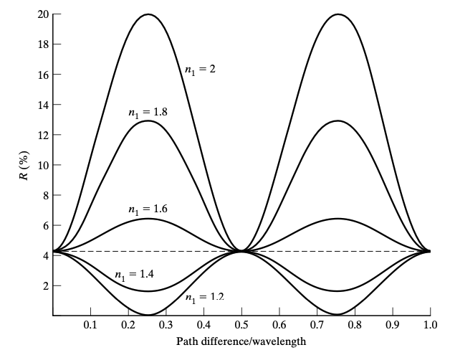
Reflectance from a Single Film
When the film has a higher refractive index than the substrate (here, glass), the reflectance is better than if it was just the substrate.
How can we increase the reflectance though?

Slide 13
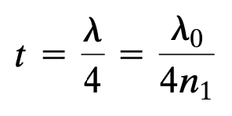

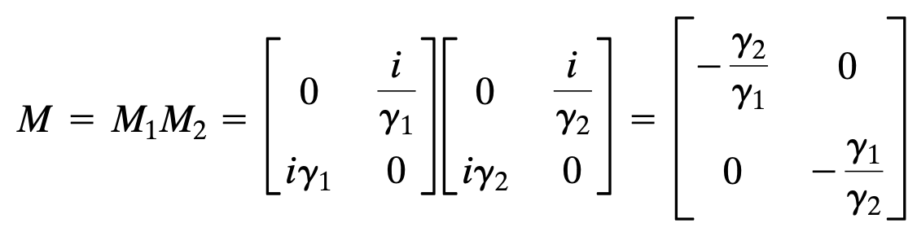
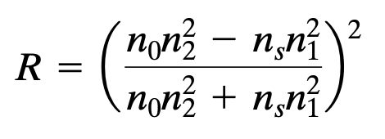
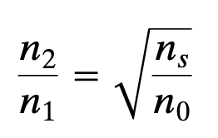
Anti-reflectance (Two Layers).
At normal incidence for quarter-wave thickness:
Zero reflectance is predicted when the 2 terms in the numerator are equal.

Slide 14
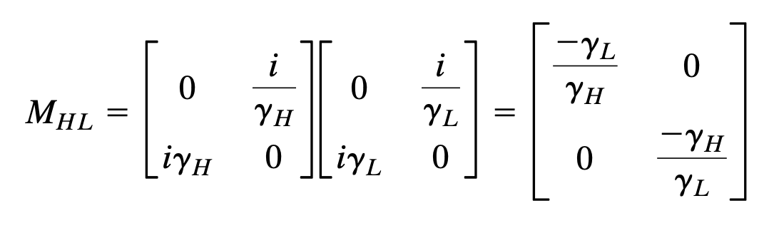
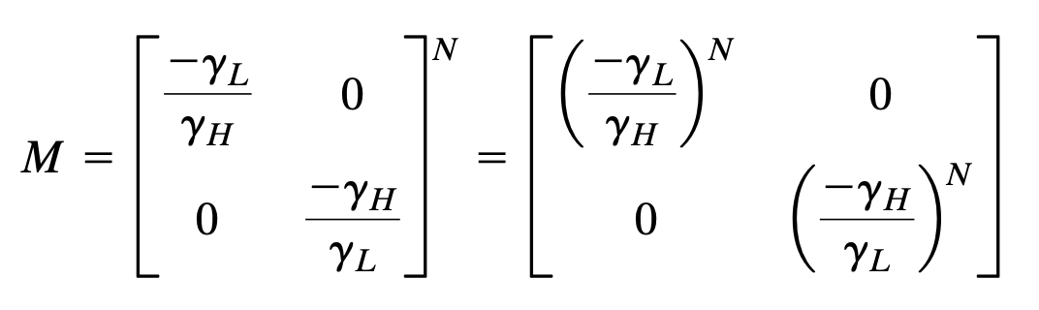
High-Reflectance Layers
Context: At a quarter-wave thickness, we can arrange layers of double-layer films optimized for antireflection in a specific order: AIR-LOW INDEX-HIGH INDEX-SUBSTRATE.
Conversely, we can optimize for high reflectivity by ordering the quarter-wave thick layers as AIR-HIGH INDEX-LOW INDEX-SUBSTRATE
For N similar layers:
A series of such double layers increases the reflectance further, and the structure is called a high-reflectance stack, or dielectric mirror.

Slide 15
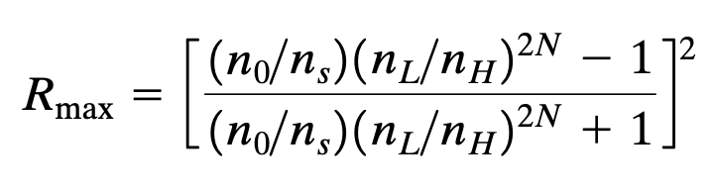
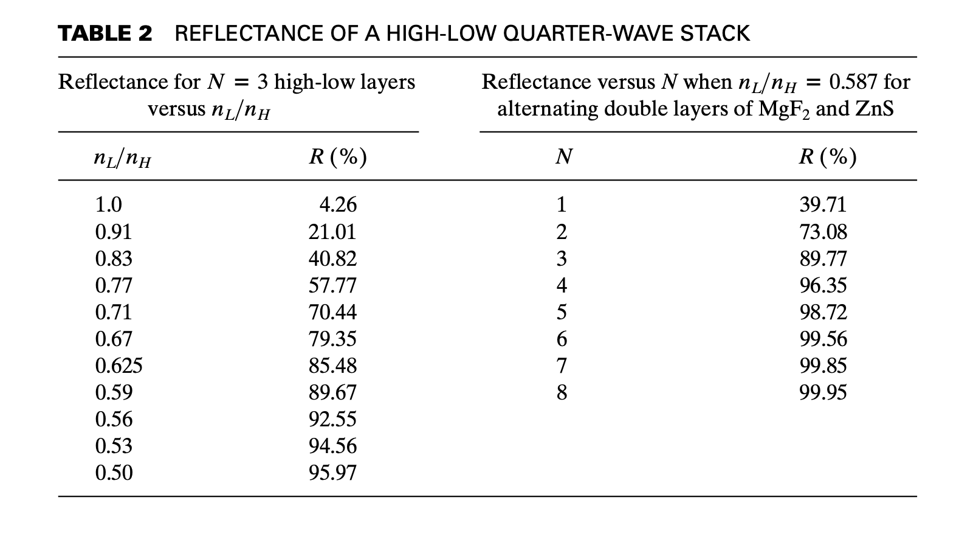
High-Reflectance Layers.
Predicts 100% reflectance when:
- N approaches infinity.
- When low/high approaches zero.

Slide 16
Additional Stuff
X-axis: path difference (n_1*t)/(lambda) where lambda=lambda_0/n_1 being the wavelength in the film.
These minima can be made to occur at different wavelengths by changing delta_1.
The magnitude of the film index determines whether the reflectance is enhanced or reduced from that of uncoated glass.
Quarter-wave thicknesses of odd multiples thereof lead to either optimum enhancement or maximum reduction in reflectance.

